Slide 1


Workflow of Image Captioning for Disaster Remote Sensing Images
Presenter: Sakura
Contact me: bili_sakura@zju.edu.cn
Date: August 19, 2024
© Sakura, 2024. All rights reserved.

Slide 2
Outline
Problem Definition
Image Captioning Models
General VLM
Remote Sensing VLM
Image Captioning for Disaster RSIs
© Sakura, 2024. All rights reserved.

Slide 3
Problem Definition
© Sakura, 2024. All rights reserved.

Slide 4
Generate High Quality Descriptions for Disaster RSIs
- ...
…
…
© Sakura, 2024. All rights reserved.

Slide 5
Image Captioning
© Sakura, 2024. All rights reserved.

Slide 6
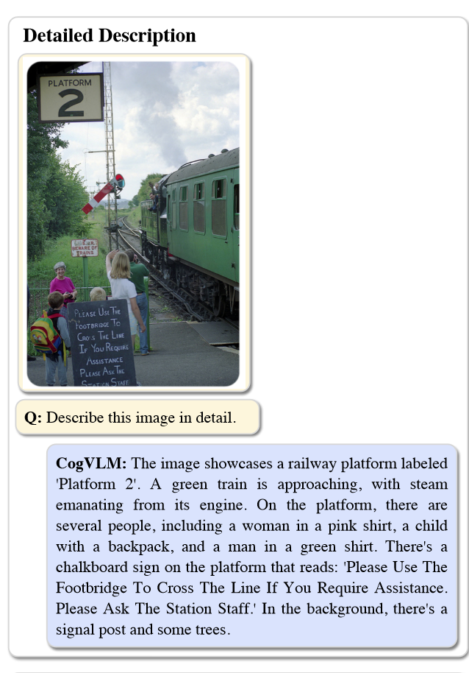
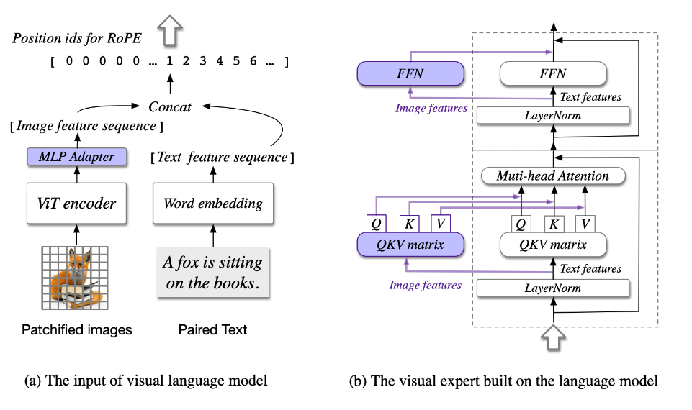
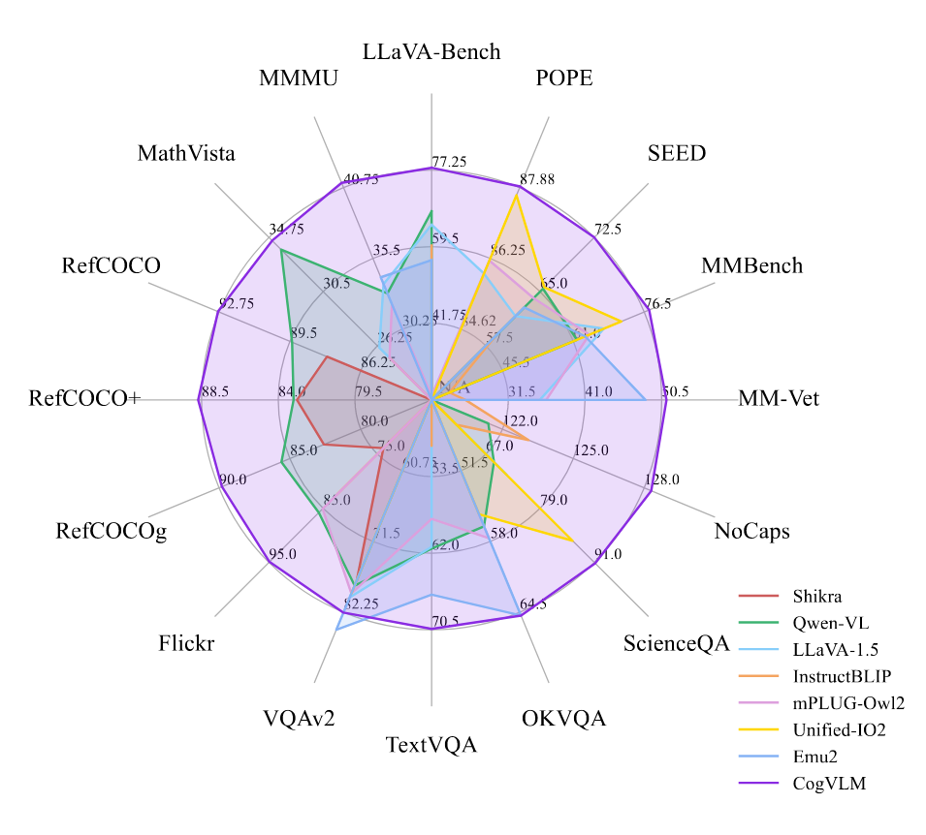
CogVLM 2
Developed by Tsinghua University and Zhipu AI
Checkpoint accessed here
…
[1] W. Wang et al., ‘CogVLM: Visual Expert for Pretrained Language Models’, Feb. 04, 2024, arXiv: arXiv:2311.03079. doi: 10.48550/arXiv.2311.03079.
© Sakura, 2024. All rights reserved.

Slide 7
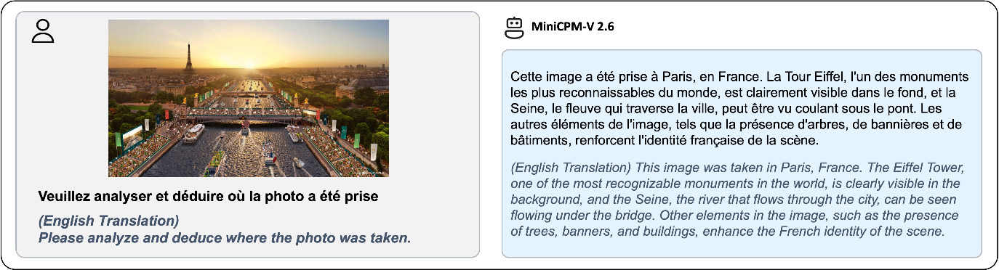
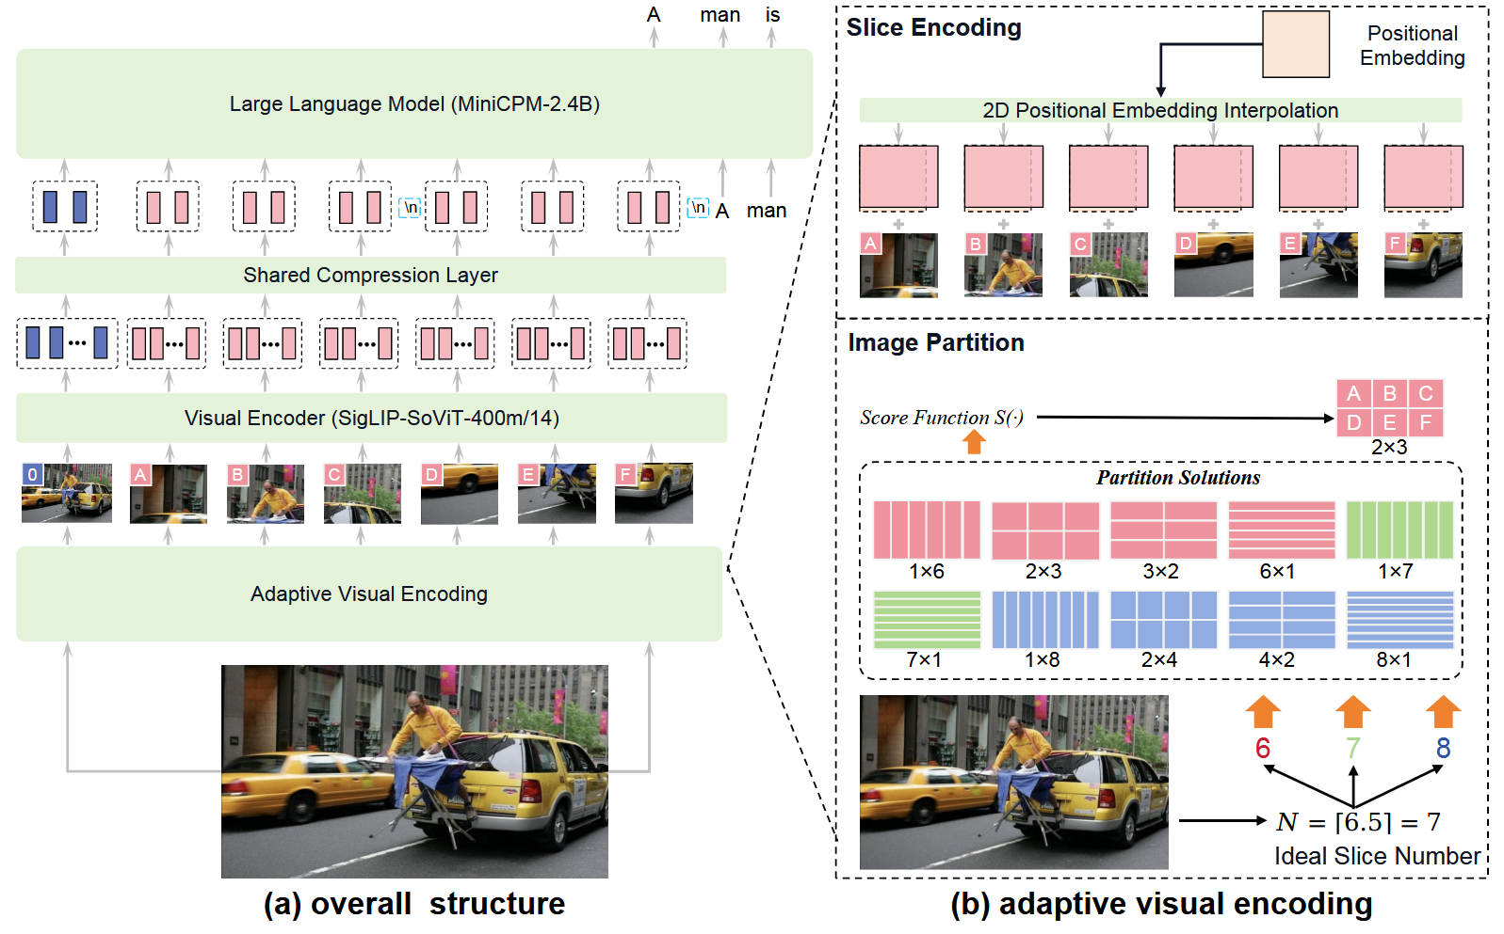
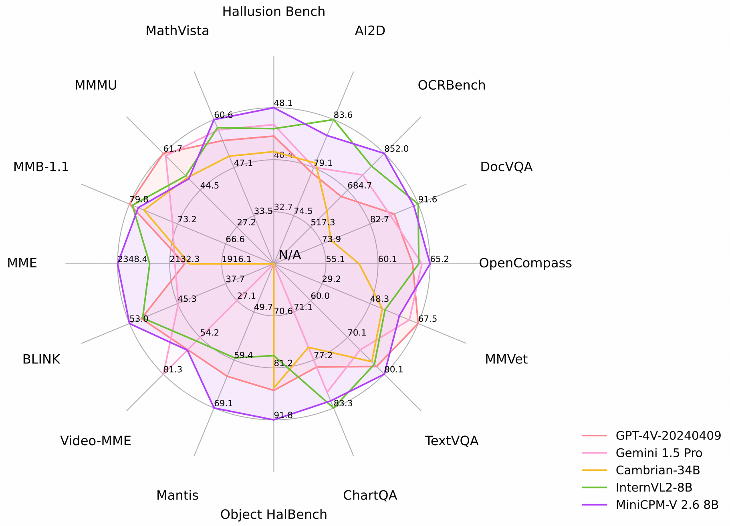
MiniCPM-V 2.6
Developed by OpenBMB
Checkpoint accessed here
…
[2] Y. Yao et al., ‘MiniCPM-V: A GPT-4V Level MLLM on Your Phone’, Aug. 03, 2024, arXiv: arXiv:2408.01800. doi: 10.48550/arXiv.2408.01800.
© Sakura, 2024. All rights reserved.

Slide 8
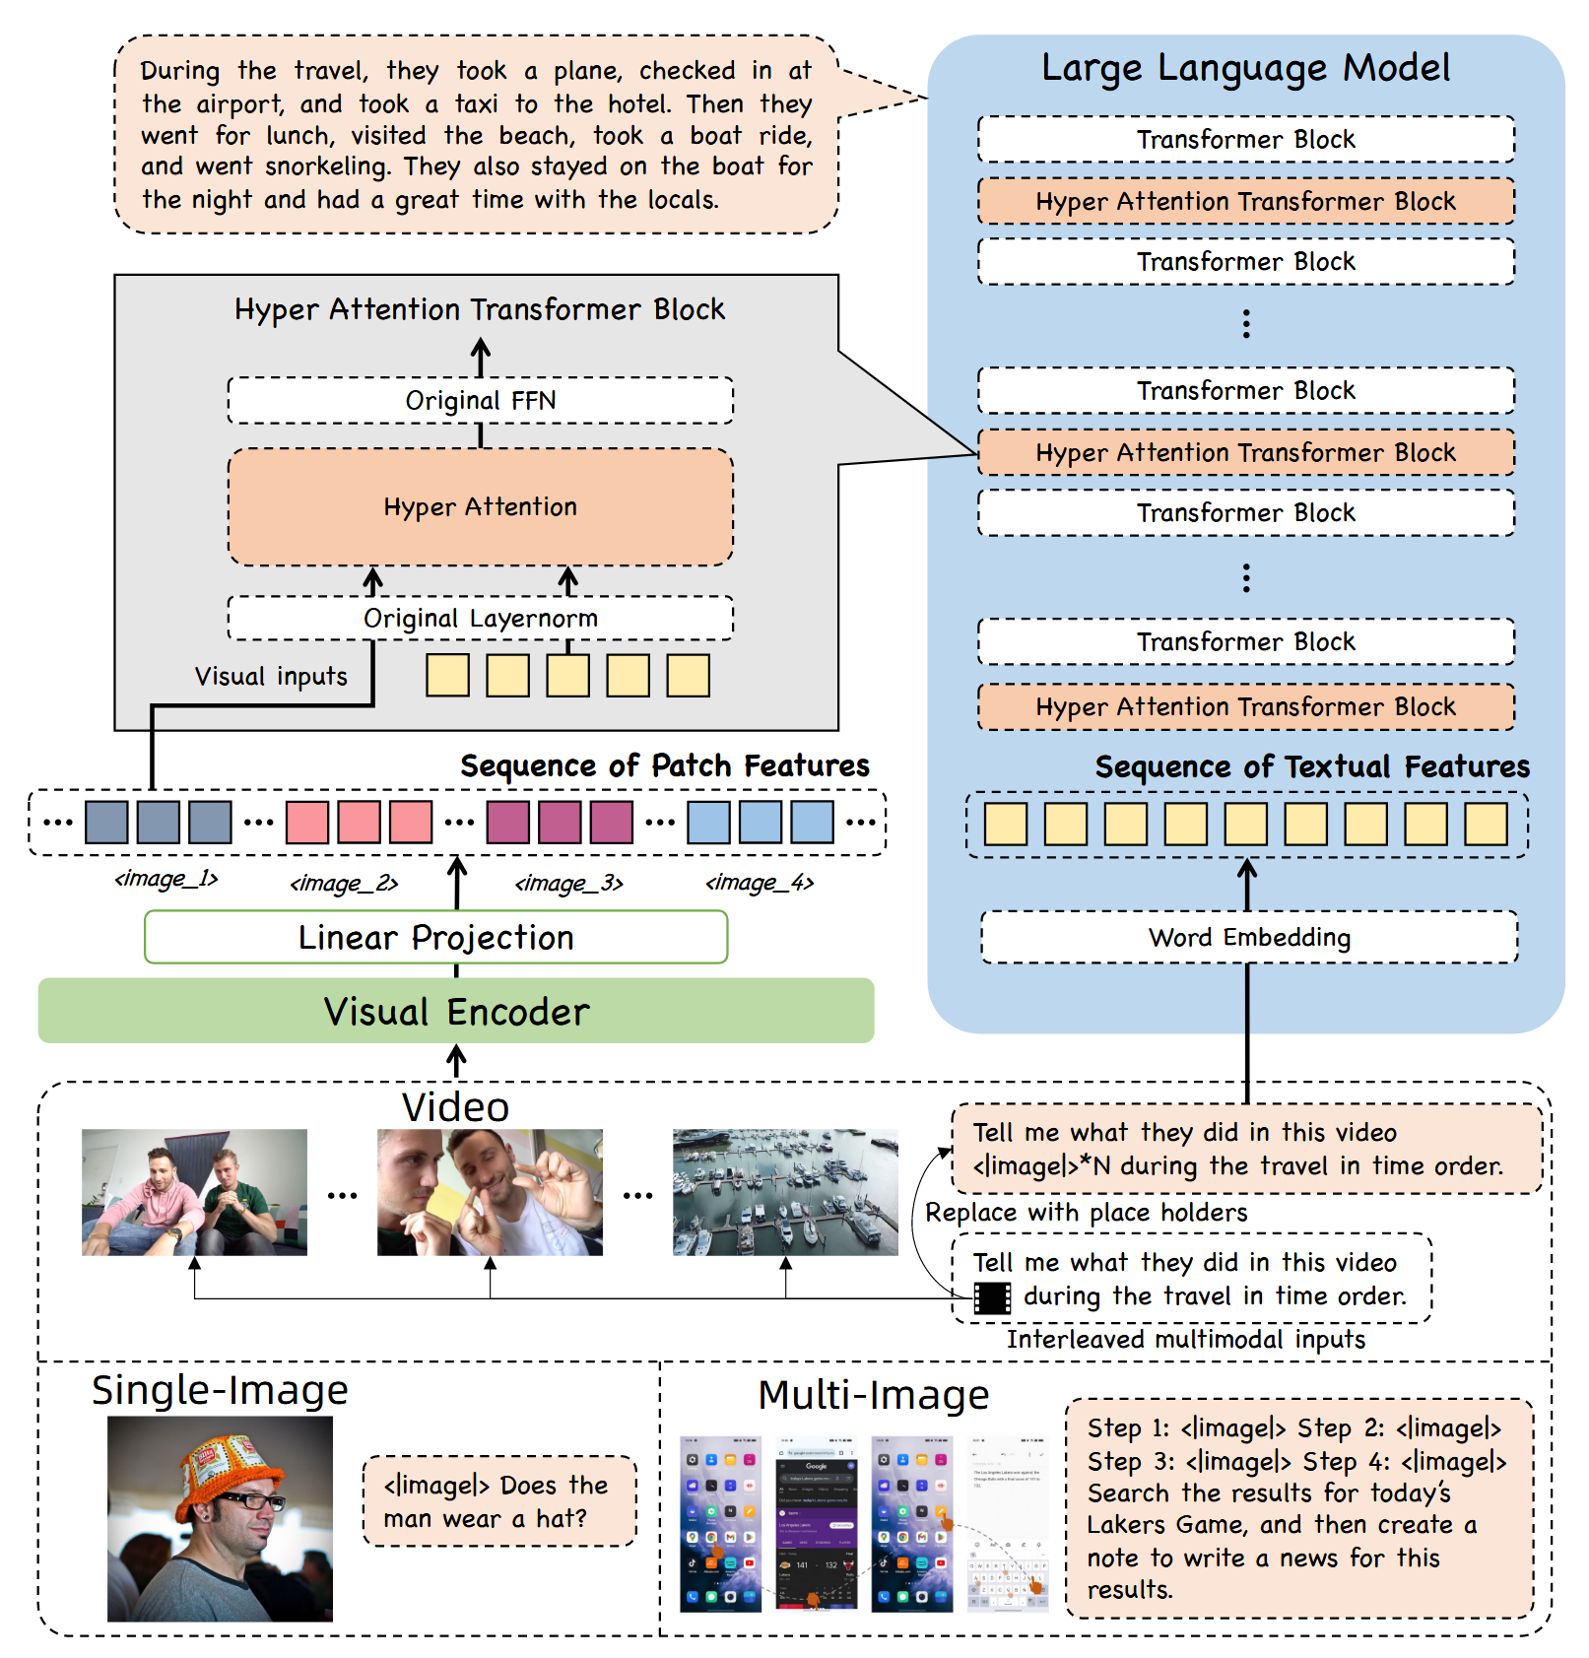
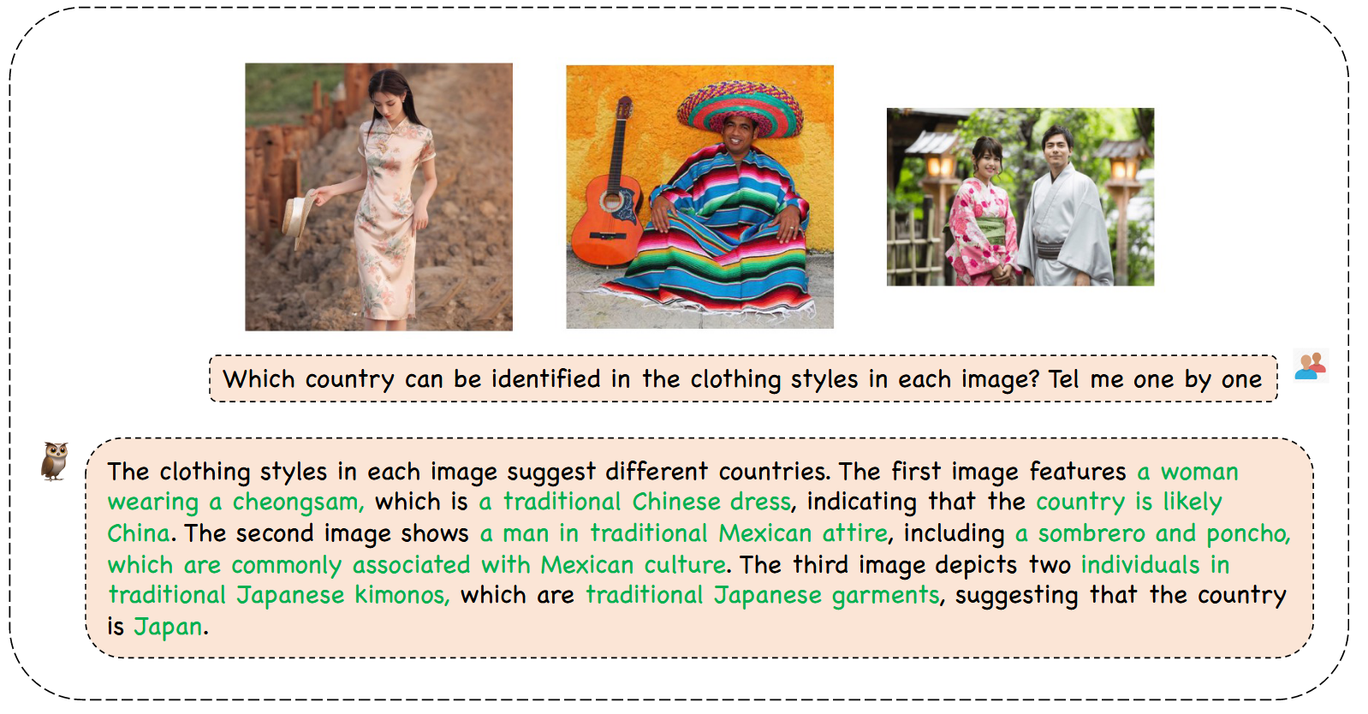
mPLUG-Owl3
Developed by Alibaba Group
Checkpoint accessed here
…
[3] J. Ye et al., ‘mPLUG-Owl3: Towards Long Image-Sequence Understanding in Multi-Modal Large Language Models’, Aug. 13, 2024, arXiv: arXiv:2408.04840.
© Sakura, 2024. All rights reserved.

Slide 9
References and Related Works
[1] W. Wang et al., ‘CogVLM: Visual Expert for Pretrained Language Models’, Feb. 04, 2024, arXiv: arXiv:2311.03079. doi: 10.48550/arXiv.2311.03079.
[2] Y. Yao et al., ‘MiniCPM-V: A GPT-4V Level MLLM on Your Phone’, Aug. 03, 2024, arXiv: arXiv:2408.01800. doi: 10.48550/arXiv.2408.01800.
[3] J. Ye et al., ‘mPLUG-Owl3: Towards Long Image-Sequence Understanding in Multi-Modal Large Language Models’, Aug. 13, 2024, arXiv: arXiv:2408.04840.
© Sakura, 2024. All rights reserved.

